Slide 1
Topic 2: Verilog Programming II
EE216 Reconfigurable Computing
Part 5: Types, Clocks and Registers
Prof. Yajun Ha

Slide 2
Types, Clocks and Registers
Data types
Numerical Representation
Bus, memory and vector operation
Synchronous/asynchronous set or reset
Synthesizable always templates
Blocking and Non-Blocking assignments
Inferring registers
Prof. Yajun Ha

Slide 3
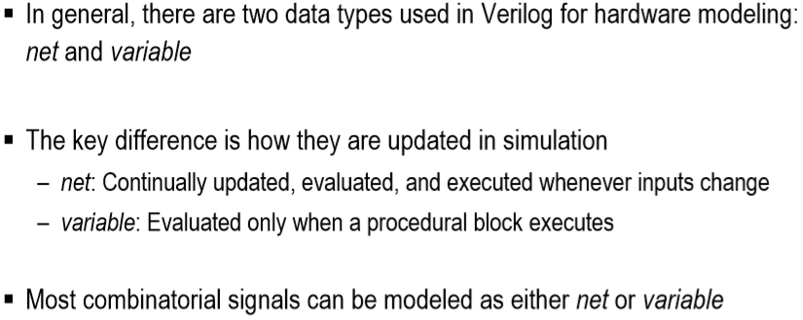

Data Types

Slide 4
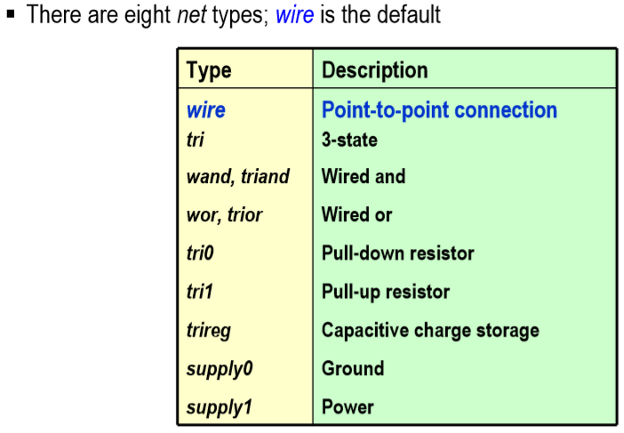
Verilog Net Types
Notes:
Title
FirstName LastName – Activity / Group

Slide 5
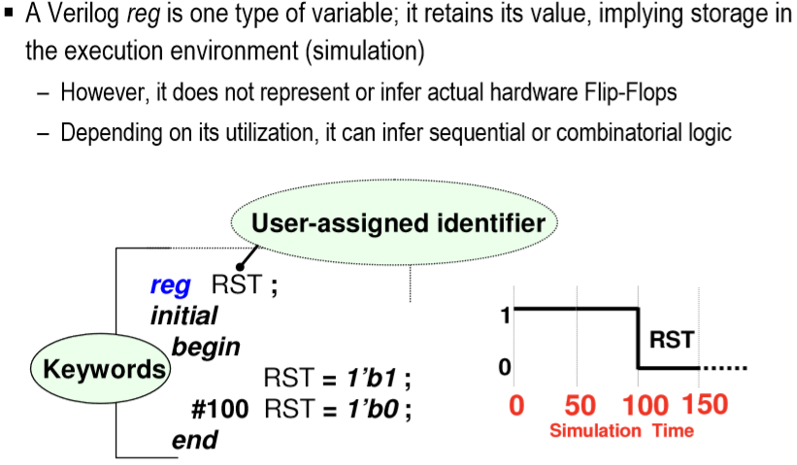
Variable Data Types
Notes:
Title
FirstName LastName – Activity / Group
In the past, systems were built by using many discrete parts, including FPGAs, memory, and I/O. Logic design tools from a variety of suppliers were (and still are) used to specify their individual functionality as well as integrating them to function together.
The CPU side of the product was (and still is) most often a discrete part. The interfacing of the CPU to the logic, memory, and I/O systems is performed through the logic tools. The software side was (and still is) implemented by using specialized tools for code and OS development. The hardware and software interfacing work is performed by using a combination of these tools and, in some cases, co-verification or co-simulation tools.
In the later part of the 1990s, many of the logic functions became integrated into single devices, such as the 4K and Virtex™ families from Xilinx. Larger amounts of memory are still off-chip, but more memory became available as new families were introduced and densities increased. This enabled more of the logic design to be developed and implemented as a single unit rather than as discrete parts that required additional interfacing. However, there were no real changes made in the CPU side of the development.
With the advent of the Platform FPGA and SoC ASICs, merging much of the discrete functionality into a single part is now reality. Unlocking the full potential of fully hardware-and-software programmable systems, both as an end product and as an advantageous development process, requires a coupling of the silicon, the hardware and software IP, and the development tools into a cohesive unit of parts and design solutions.

Slide 6
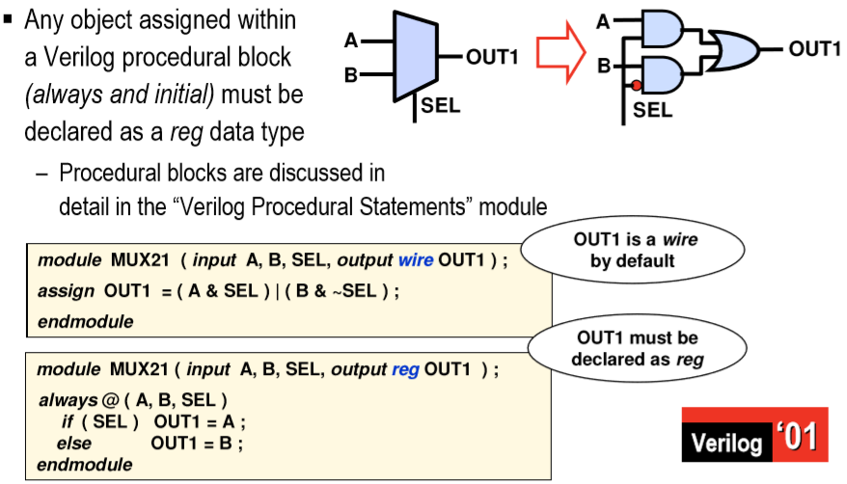
Comparing reg versus wire

Slide 7
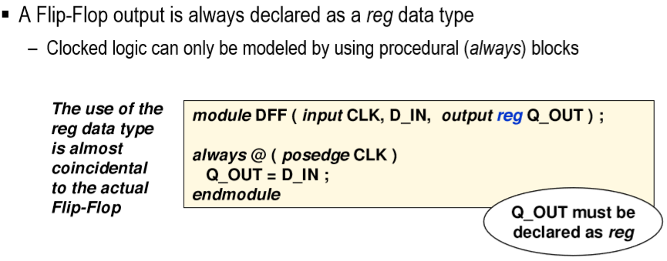
reg and Flip-Flop Confusion

Slide 8
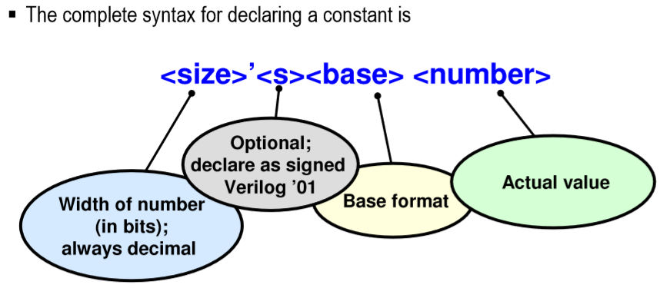
Numerical Representation

Slide 9
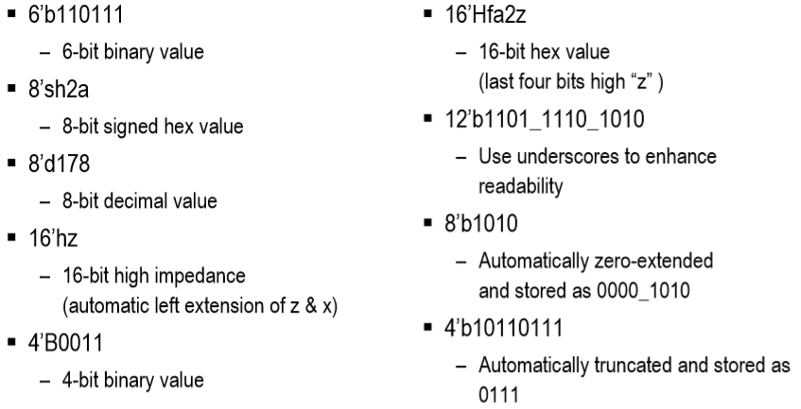
Explicitly Sized Numbers

Slide 10
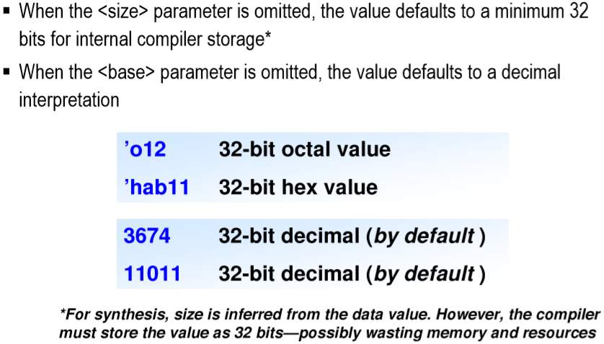
Implicitly Sized Numbers

Slide 11
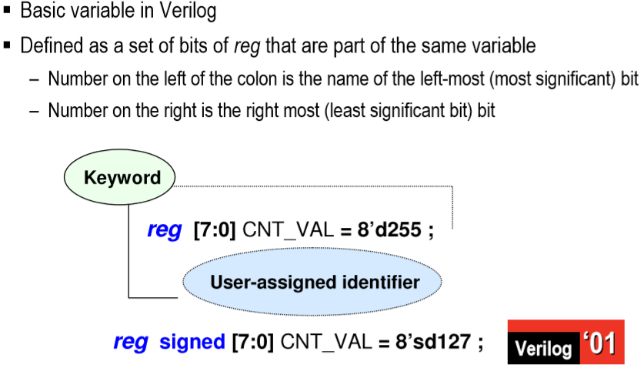
Buses of reg

Slide 12
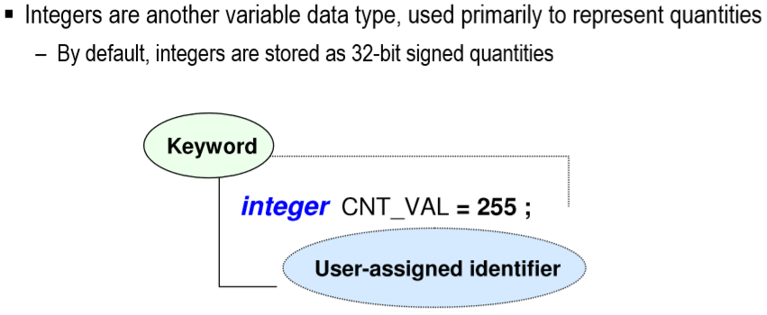
Integers

Slide 13
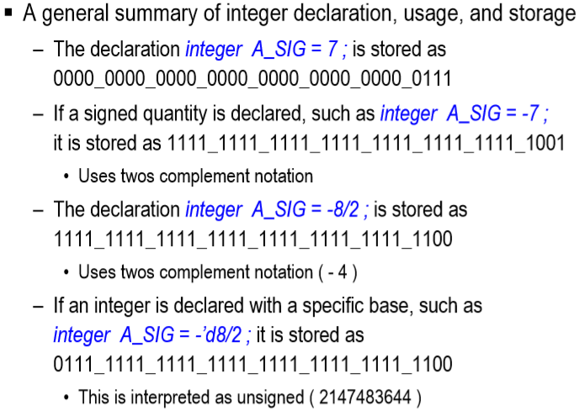
Integer Usage

Slide 14
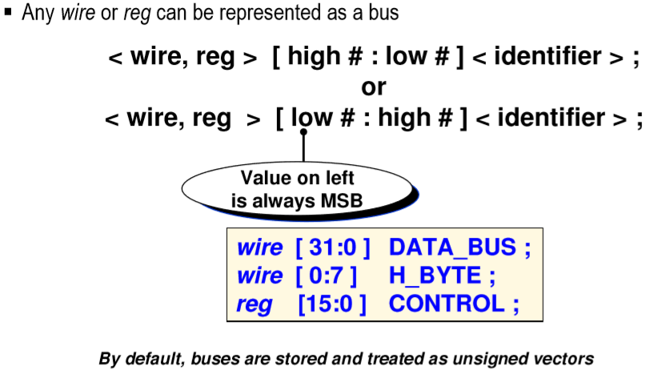
Bus Declaration (1)

Slide 15
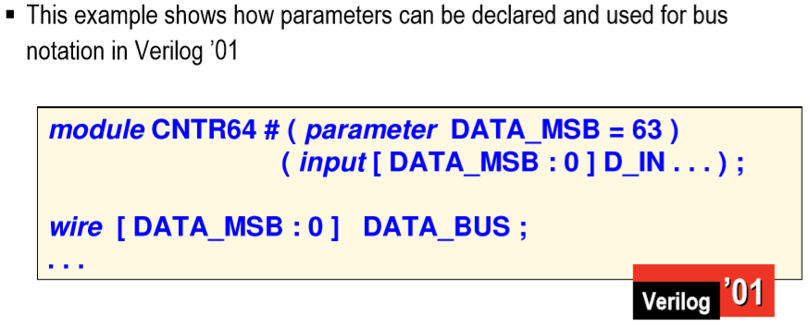
Bus Declaration（2）

Slide 16
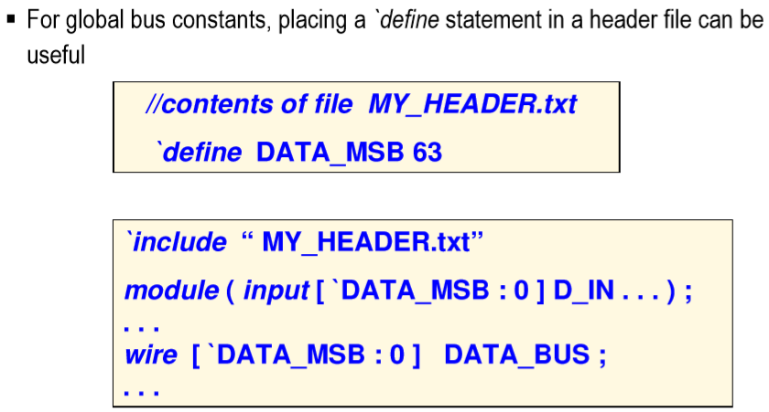
Bus Declaration (3)
Notes:
Title
FirstName LastName – Activity / Group
What are the major factors to be considered for the design of an embedded SoC?
The most important factor is TTM. In other words, you must design and sell it faster than others or you lose. I’ll explain this in the following slides.
The technology advances rapidly and there are lots of challenges.
Leveraging on the advances in the technology, we must be able to satisfy the ever-increasing performance need.
Power consumption is another important issue.
Reliability, ...
Cost is still an important issue. Chip area is the most concern in our case.

Slide 17
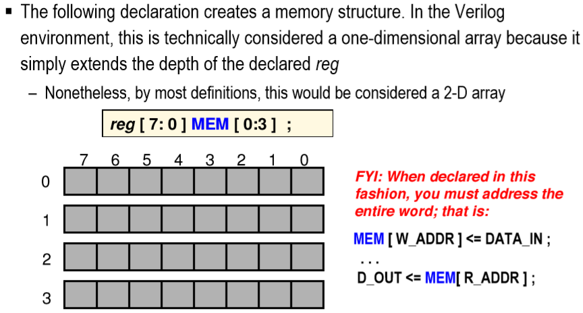
Memory

Slide 18
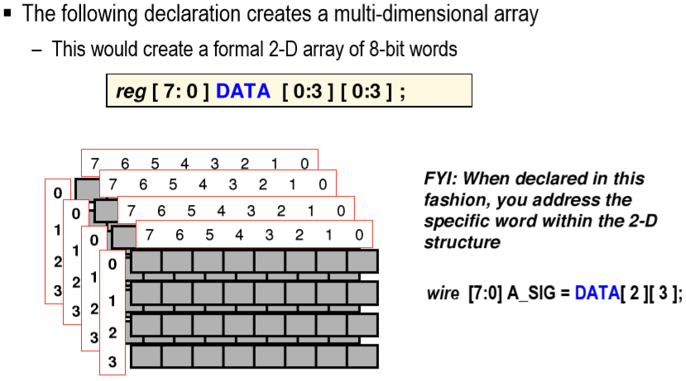
Multi-Dimensional Memory

Slide 19
Bit select
Any single bit within a vector or array can be referenced individually as a bit select
wire [0:7] V;
wire [3:0] F;
V[2]
assign F[3] = V[2];
F[3]
Prof. Yajun Ha

Slide 20
Bit part select
Any contiguous group of nets in a bus can be referenced as a slice or part select
V[2:4]
wire [0:7] V;
wire [2:0] F;
assign F[2:0] = V[2:4];
Note: The direction of the part select must match the original bus declaration:
  V[2:4] OK
  V[4:2] ERROR
F[2:0]
Prof. Yajun Ha

Slide 21
Concatenation
wire [7:0] A, B;
wire [15:0] F;
Note: The concatenation operator can be used on both the left and right sides of assignments:
  assign F = {A, B}; OK
  assign {A, B} = F; OK
assign F = {A, B};
7 6 5 4 3 2 1 0
7 6 5 4 3 2 1 0
{A
, B
}
15 14 13 12 11 10 9 8
7 6 5 4 3 2 1 0
Prof. Yajun Ha

Slide 22
Shifting
wire [N-1:0] REG;
assign REG = {REG[N-2: 0], 1’b0};
N-1 N-2
3 2 1 0
REG before
N-1 N-2
3 2 1 0
REG after
Prof. Yajun Ha

Slide 23
Replication
wire [2:0] a, b;
wire [11:0] c;
assign c = {2{a, b}};
a
b
{2{a
, b
}}
{2{
}}
c
Prof. Yajun Ha

Slide 24
Synchronous Reset
always @(posedge clk)
begin
if (reset == 1’b1) begin
Q <= 1’b0;
end else begin
Q <= D;
end
end
Synchronous reset
D
Q
reset
D-FF
clk
Prof. Yajun Ha

Slide 25
Asynchronous Set or Reset
always @(posedge clk, posedge reset)
begin
if (reset == 1’b1) begin
Q1 <= 1’b0;
end else begin
Q1 <= D;
end
end
Asynchronous reset
D
Q1
D-FF
clk
reset
always @(posedge clk, posedge set)
begin
if (set == 1’b1) begin
Q1 <= 1’b1;
end else begin
Q1 <= D;
end
end
D
Q2
D-FF
clk
set
Prof. Yajun Ha

Slide 26
Synthesizable Always Templates
always @(*)
begin
… pure combinational logic
end
always @(posedge clk)
begin
… Flipflops + logic
end
always @(*)
begin
if (enable == 1’b1) begin
… transparent latches
end
end
always @(posedge clk, posedge reset)
begin
if (reset == 1’b1) begin
…Asynchronous actions
end else begin
Synchronous actions
end
end
always
begin
@(posedge clock);
… Flipflops + logic
end
Prof. Yajun Ha

Slide 27
RTL Synthesis
Clock
RTL synthesis does not add, delete or move registers. RTL synthesis does optimize the combinational logic between the registers.
The consequence is that you have to be constantly aware of where, when and how flip-flops will be synthesized as you write the RTL Verilog code, because the flip-flops will determine the architecture of your design and they act like brick walls during optimization.
Prof. Yajun Ha

Slide 28
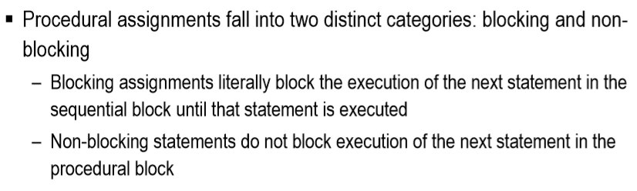
Blocking vs. Non-Blocking
Notes:
Title
FirstName LastName – Activity / Group

Slide 29
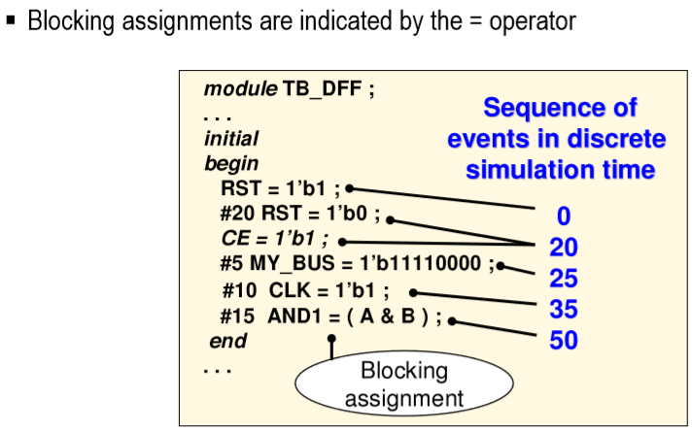
Blocking
Notes:
Title
FirstName LastName – Activity / Group

Slide 30
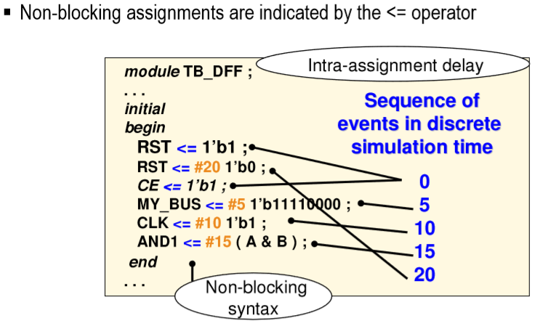
Non-Blocking
Notes:
Title
FirstName LastName – Activity / Group

Slide 31
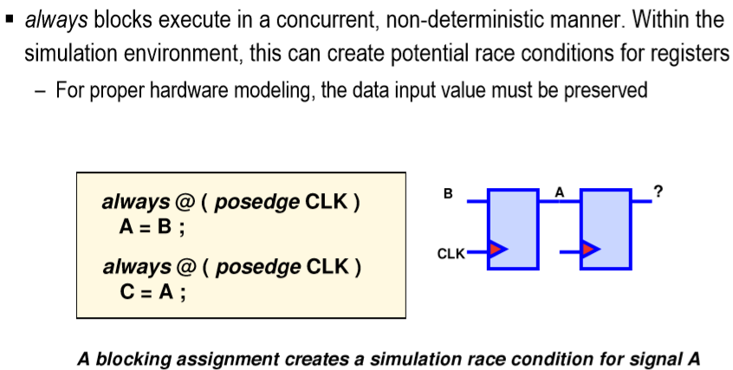
Why Non-Blocking
Notes:
Title
FirstName LastName – Activity / Group

Slide 32
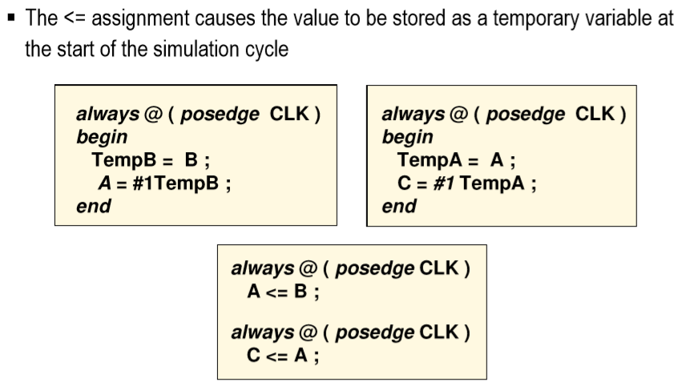
Effect of Non-Blocking
Notes:
Title
FirstName LastName – Activity / Group

Slide 33
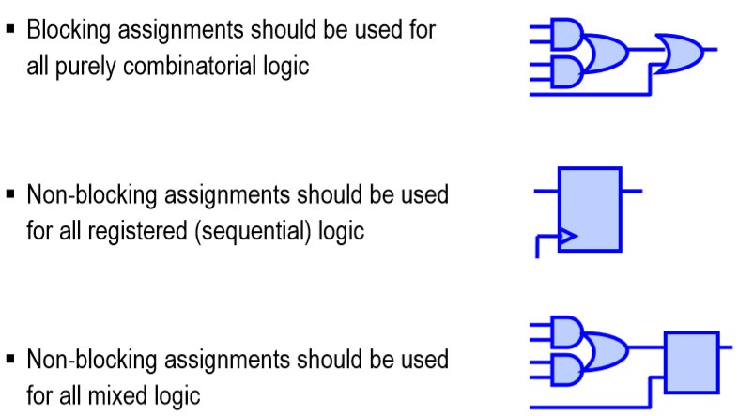
Blocking and Non-Blocking Uses
Notes:
Title
FirstName LastName – Activity / Group

Slide 34
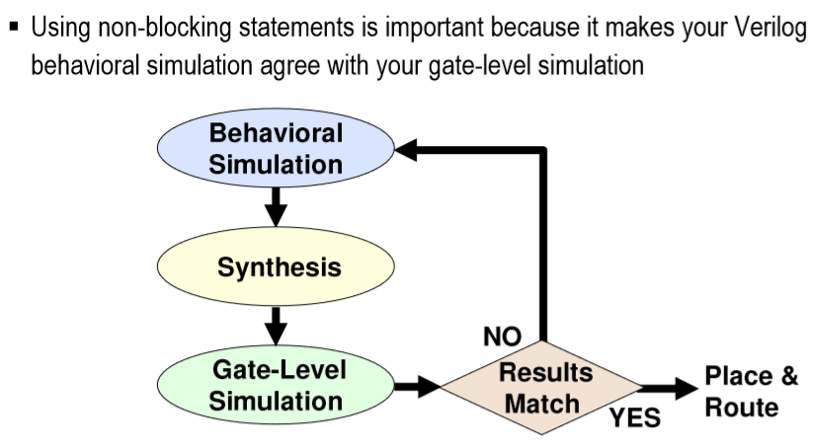
Blocking and Non-Blocking
Notes:
Title
FirstName LastName – Activity / Group

Slide 35
Implying Registers
reg [11:0] NextA;
reg Up;
…
assign NextA = Acc + Delta;
always @(posedge clk) begin
if (Up == 1’b1) begin
if (NextA >= Max) begin
Up <= 1’b0;
end
end
Acc <= NextA;
end
NextA
Delta
+/-
Acc
Max
Up
>=
clk
Prof. Yajun Ha

Slide 36

Topic 2: Verilog Programming II
EE216 Reconfigurable Computing
Part 6: FSM Synthesis and Test Bench
Prof. Yajun Ha

Slide 37
FSM Synthesis and Test Bench
Moore and Mealy machines
State transition diagrams
Explicit state machines
Multiple always style
State encoding
Unreachable states
Test Bench
Prof. Yajun Ha

Slide 38
Finite State Machines
Moore outputs depend only on state
Next-state logic
Output logic
Outputs
State
register
Inputs
Clock
Mealy outputs depend only on inputs
The FSM uses the values of its inputs and its current state to determine the values of its outputs and its next state. We will only consider synchronous state machines, where the state machine changes state on the active edge of the clock.
The hardware architecture of a FSM consists of a state register, combinational logic to calculate the next state, and combinational logic to calculate the outputs.
Prof. Yajun Ha

Slide 39
State Transition Diagrams
Start = 0
Reset = 1
Start = 1
Go1
F=1
Inputs
Idle
Reset
Start
Outputs
Defaults
Go2
G=1
F
F = 0
G
G = 0
Each bubble in the diagram represents a different internal state of the machine. The arrows connecting the bubbles represent state transitions, and the annotations on some of the arrows (e.g. Start = 1) are the input conditions under which that particular state transition will occur. Each bubble contains a symbolic name for that state (e.g. Idle), and the output values in that state.
Prof. Yajun Ha

Slide 40
Explicit State Machine Description
always @(posedge clk, posedge reset) begin
if (reset = 1’b1) begin
State <= Idle;
F <= 1’b0;
G <= 1’b0;
end else begin
case (State)
Idle:
if (Start =1’b1) begin
State <= Go1;
F <= 1’b1;
end;
Go1:
State <= Go2;
F <= 1’b0;
G <= 1’b1;
Go2:
State <= Idle;
G <= 1’b0;
endcase
end
end
reg [1:0] State;
parameter Idle = 2’d0;
parameter Go1 = 2’d1;
parameter Go2 = 2’d2;
FSM should have a reset
Prof. Yajun Ha

Slide 41
State Machine Architecture
State
Flip-flops on the outputs are not wanted!
Combinational logic
Inputs
Outputs
Preceding process
Next-state logic
Output logic
Outputs
Inputs
Textbook Moore machine
Prof. Yajun Ha

Slide 42
Separate Output Decoding
reg [1:0] State;
parameter Idle = 2’d0;
parameter Go1 = 2’d1;
parameter Go2 = 2’d2;
…
always @(posedge clk, posedge reset) begin
if (reset = 1’b1) begin
State <= Idle;
end else begin
case (State)
Idle:
if (Start = 1’b1) begin
State <= Go1;
end
Go1:
State <= Go2;
Go2:
State <= Idle;
endcase
end
end
always @(State)
begin
F = 1’b0;
G = 1’b0;
if (State == Go1)
F = 1’b1;
else if (State == Go2)
G = 1’b1;
end
Prof. Yajun Ha

Slide 43
Separating Registers from C-Logic
reg [1:0] State, NextState;
parameter Idle = 2’d0;
parameter Go1 = 2’d1;
parameter Go2 = 2’d2;
…
always @(posedge clk, posedge reset) begin
if (reset == 1’b1) begin
State <= Idle;
end else begin
State <= NextState;
end
end
always @(State, Start) begin
F = 1’b0;
G = 1’b0;
case (State)
Idle:
if (Start = 1’b1) begin
NextState = Go1;
end else begin
NextState = Idle;
end
Go1:
NextState = Go2;
F = 1’b1;
Go2:
NextState = Idle;
G = 1’b1;
Default:
NextState = Idle;
endcase
end
can be removed?
Prof. Yajun Ha

Slide 44
State Encoding
parameter Idle = 2’d0;
parameter Go1 = 2’d1;
parameter Go2 = 2’d2;
State Name | Binary | One Hot
Idle | “00” | “100”
Go1 | “01” | “010”
Go2 | “10” | “001”
parameter Idle = 3’b100;
parameter Go1 = 3’b010;
parameter Go2 = 3’b001;
Prof. Yajun Ha

Slide 45
Unreachable States
parameter Idle = 2’d0;
parameter Go1 = 2’d1;
parameter Go2 = 2’d2;
State Name | Binary
Idle | “00”
Go1 | “01”
Go2 | “10”
- | “11”
parameter Idle = 3’b100;
parameter Go1 = 3’b010;
parameter Go2 = 3’b001;
3 states
2 flip-flops
4 hardware states
1 unreachable state and therefore no control of it
Prof. Yajun Ha

Slide 46
Controlling Unreachable States
parameter Idle = 2’d0;
parameter Go1 = 2’d1;
parameter Go2 = 2’d2;
State Name | Binary
Idle | “00”
Go1 | “01”
Go2 | “10”
- | “11”
parameter Idle = 3’b100;
parameter Go1 = 3’b010;
parameter Go2 = 3’b001;
case (State)
Idle: …
Go1: …
Go2: …
default:
State <= Idle;
endcase
Explicitly define behavior of hardware in unreachable state!
Prof. Yajun Ha

Slide 47
Test Benches
Should cover >=90% code!
Test vectors
RAM/ROM contents
Expected results
Stimulus
Design under test
Results
Handshake
Test Bench
Trace
Diagnostics
Prof. Yajun Ha

Slide 48
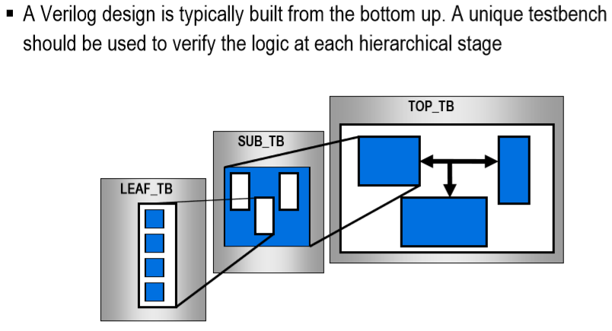
Verify at Each Level

Slide 49
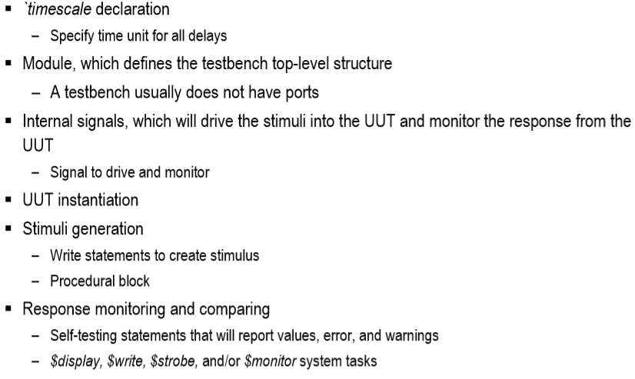
Components of a Testbench

Slide 50
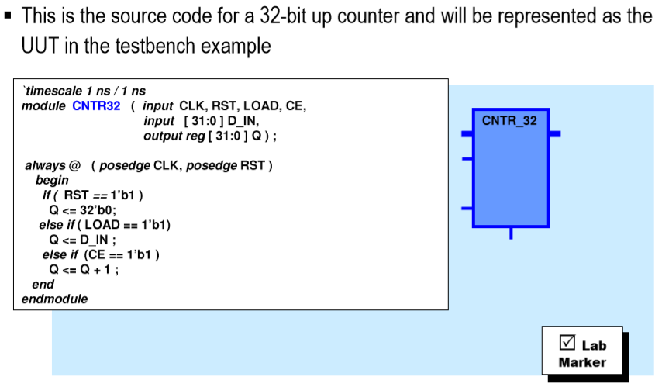
Testbench Example
Notes:
Title
FirstName LastName – Activity / Group
Before I introduce the HVM to you, I think it is better to start by introducing what it is a Java Virtual Machine, because it is quite related to HVM and it is where I have started. So, what it is a JVM. If I say it in one sentence, I would say it is a technology to help you write your code once and executes everywhere.
I believe most of you have the experience of porting programs from one platform to another platform. That is because computing platforms are normally consisting of different combinations of processors and operating systems. For example, you could have a platform with Pentium processor with Windows OS, or you could have a SUN workstation with Solaris OS.
Before Java was developed, if you want you applications to execute on several platforms, then you need to modify your code and write platform specific code.
But with the Java tech, it helps you to write your code once, and ensures it to execute everywhere. It mainly achieves that by doing it in a two step strategy. In the first step, it maps the Java program into an intermediate representation by targeting the Java codes on a virtual CPU, and then in a second step at the clients side, JVM will translate these bytecode into native code for each of the platform
By doing that, platform independence can be achieved.

Slide 51
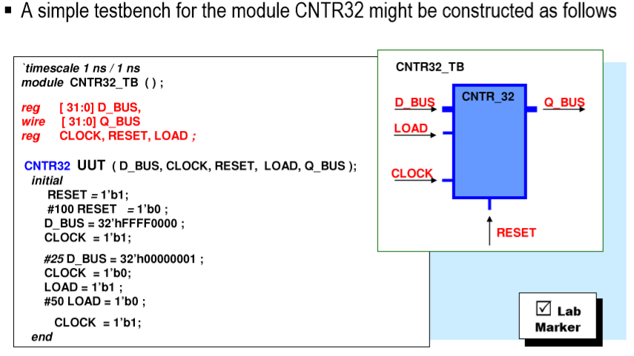
CNTR32 Testbench
Notes:
Title
FirstName LastName – Activity / Group

Slide 52
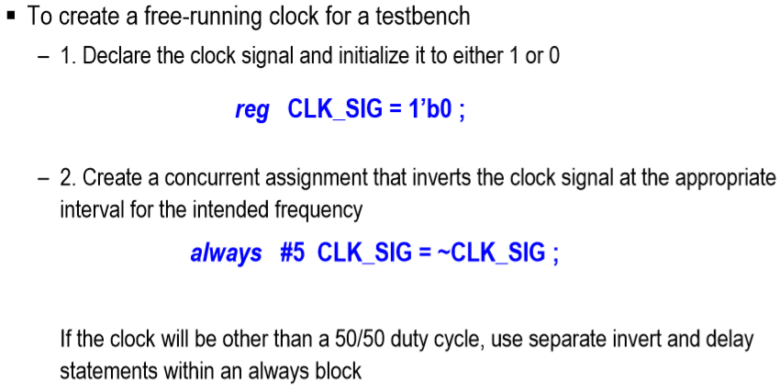
Creating Clock Signals

Slide 53
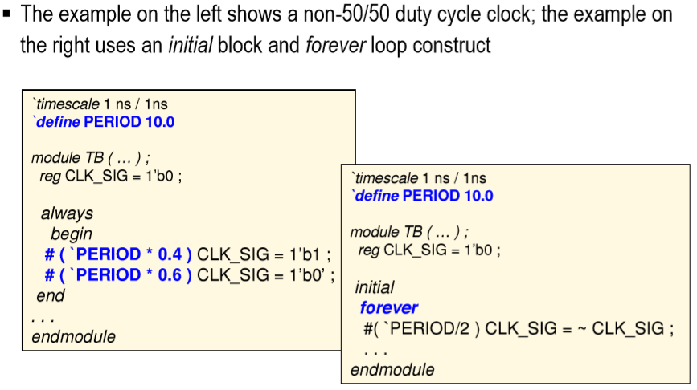
Other Clock Approaches
Notes:
Title
FirstName LastName – Activity / Group

Slide 54
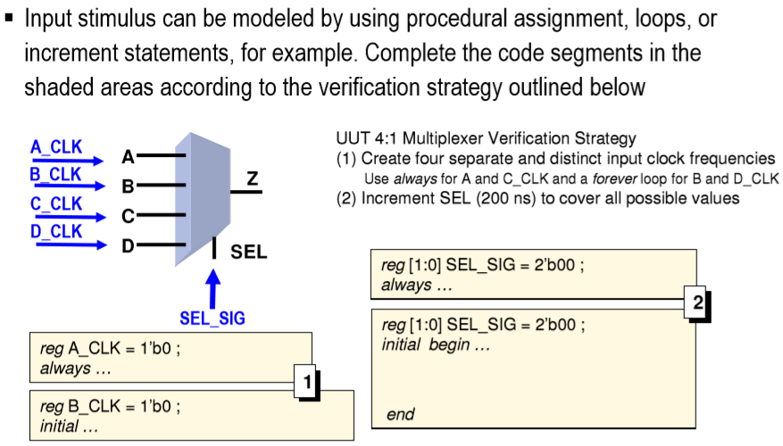
Modeling Input Stimulus
Notes:
Title
FirstName LastName – Activity / Group

Slide 55
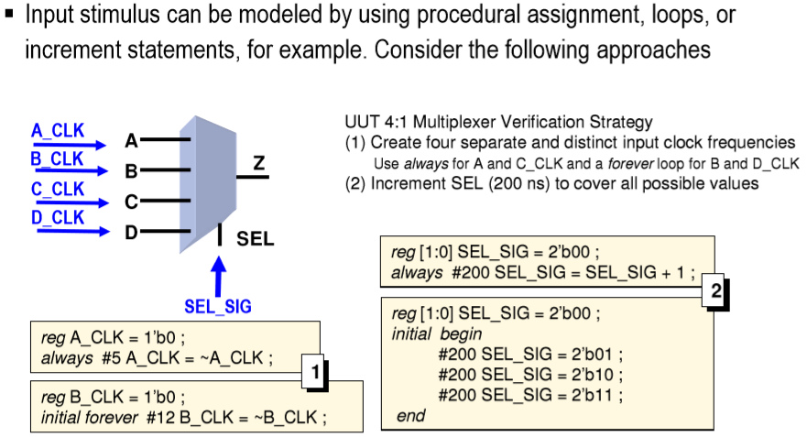
One Possible Solution
Notes:
Title
FirstName LastName – Activity / Group

